Slide 1
MULTI-CUT REBAR(9)
Advisor : Prof. K.C.Chang
Presenters : You-Ran Nai

Slide 2
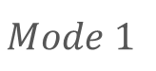
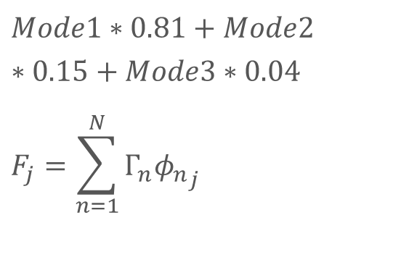
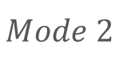
Mode Pushover
0.525
-0.319
0.427
$$Mode1∗0.81+Mode2∗0.15+Mode3∗0.04$$
$$F_{j}=\sum_{n=1}^{N}{Γ_{n}{φ_{n}}_{j}}$$
0.343
0.321
0.402
0.132
0.359
0.171
$$Mode 1$$
$$Mode 2$$
MMC
Notes:
Pushover mode 1, 2, MMC
柱產生塑角

Slide 3


Slide 4
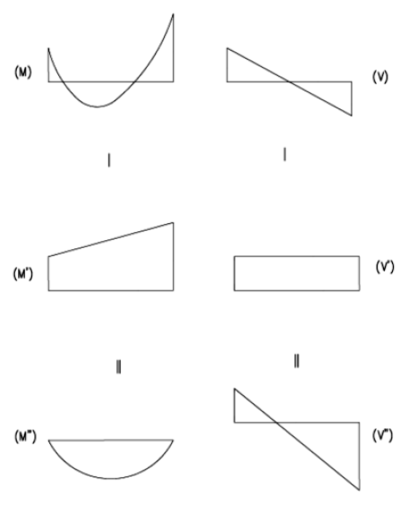
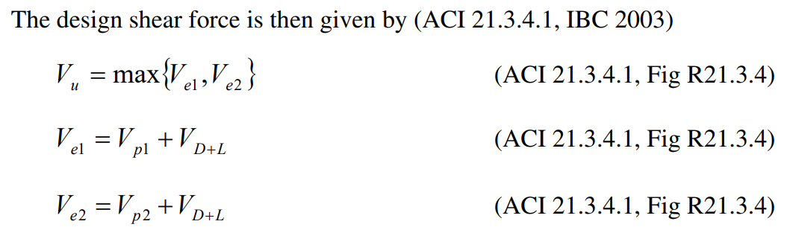
Sway Special

Slide 5
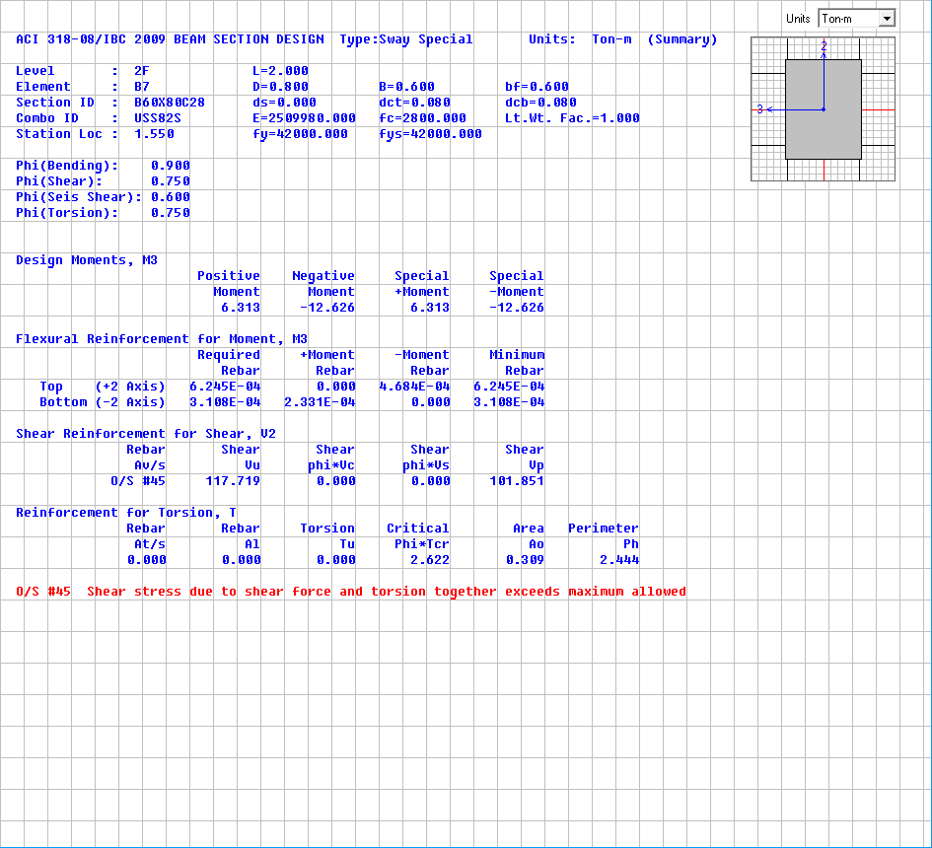
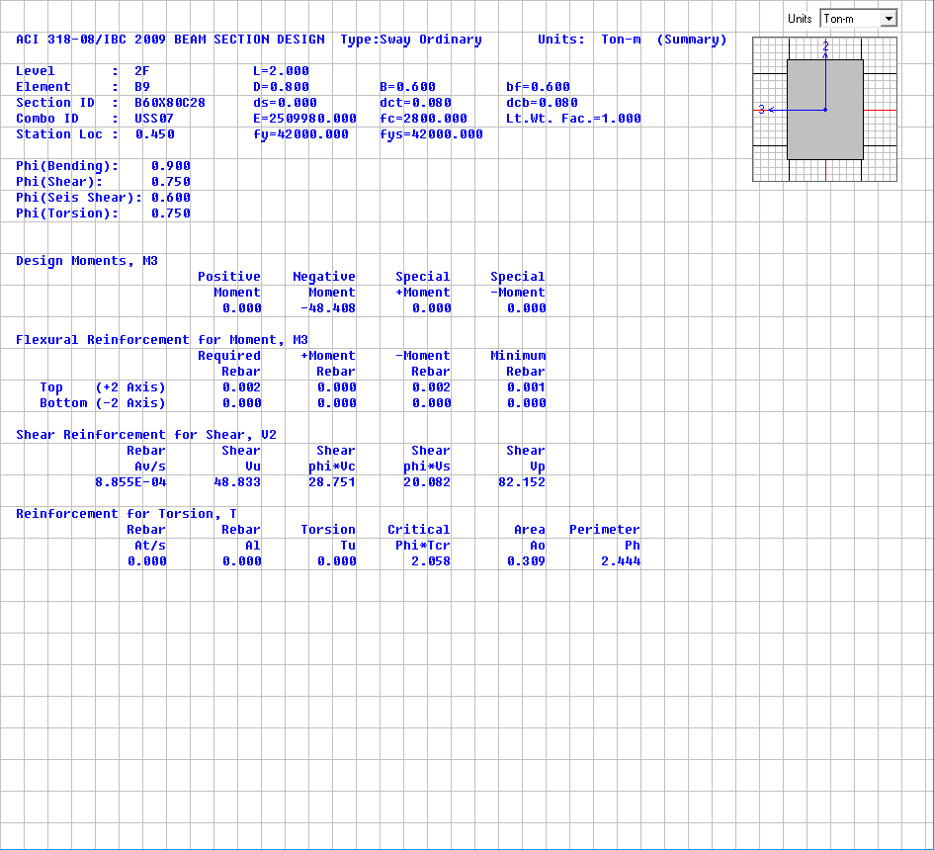
Shear Design
Sway Special(Consider Vp)
Sway Ordinary(No Consider Vp)
Vp=101.851t
Vu=117.719t
Vp=82.152t
Vu=48.833t

Slide 6
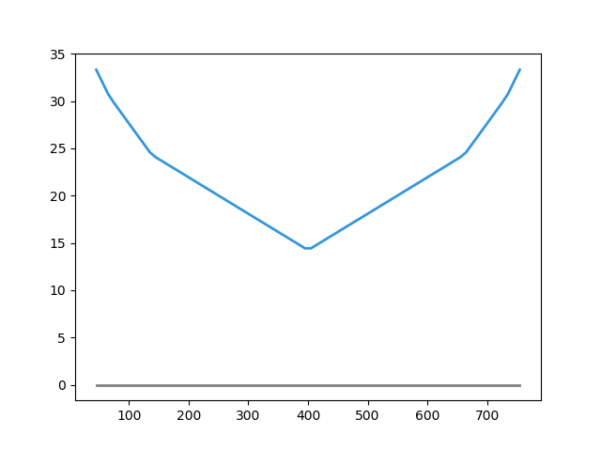
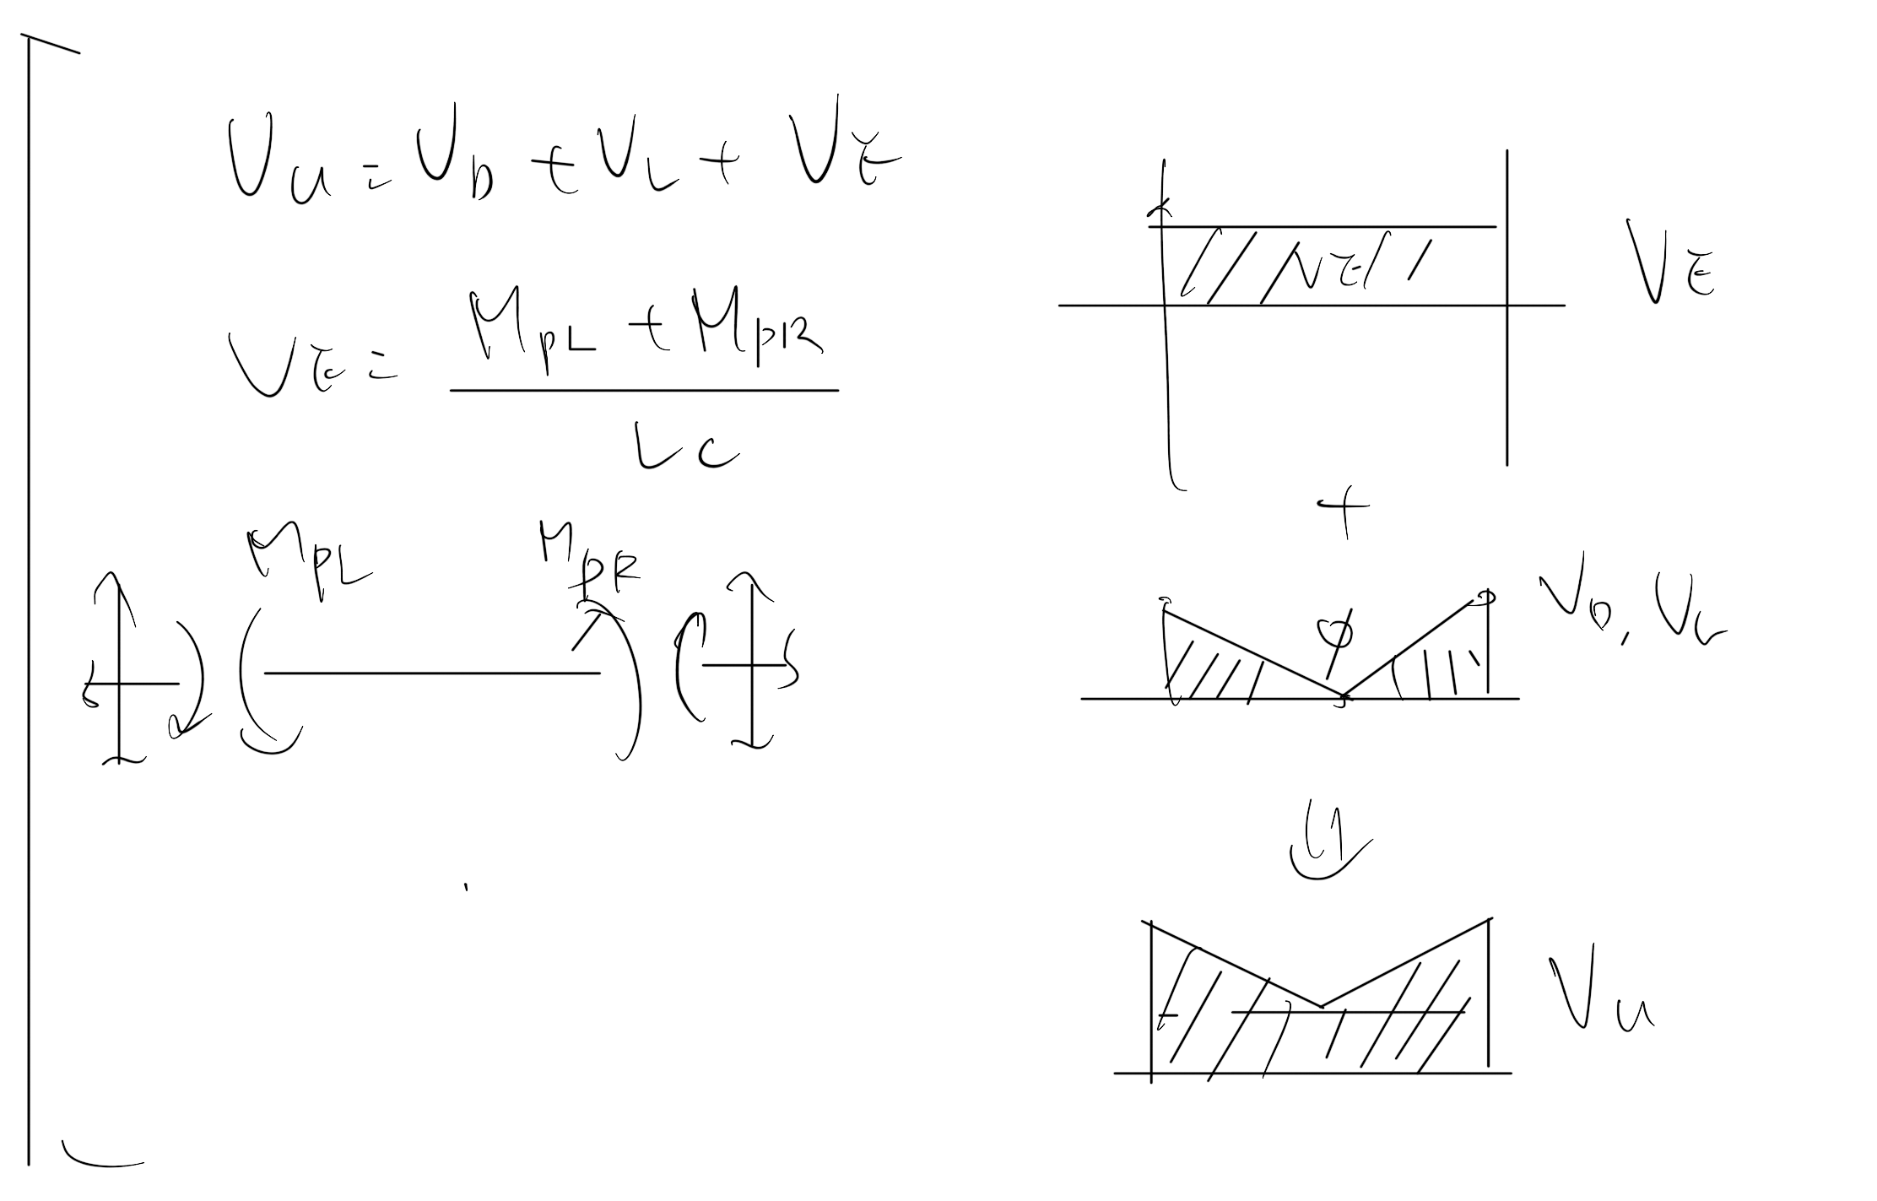
Shear Design
Easbs Shear Rebar Area

Slide 7
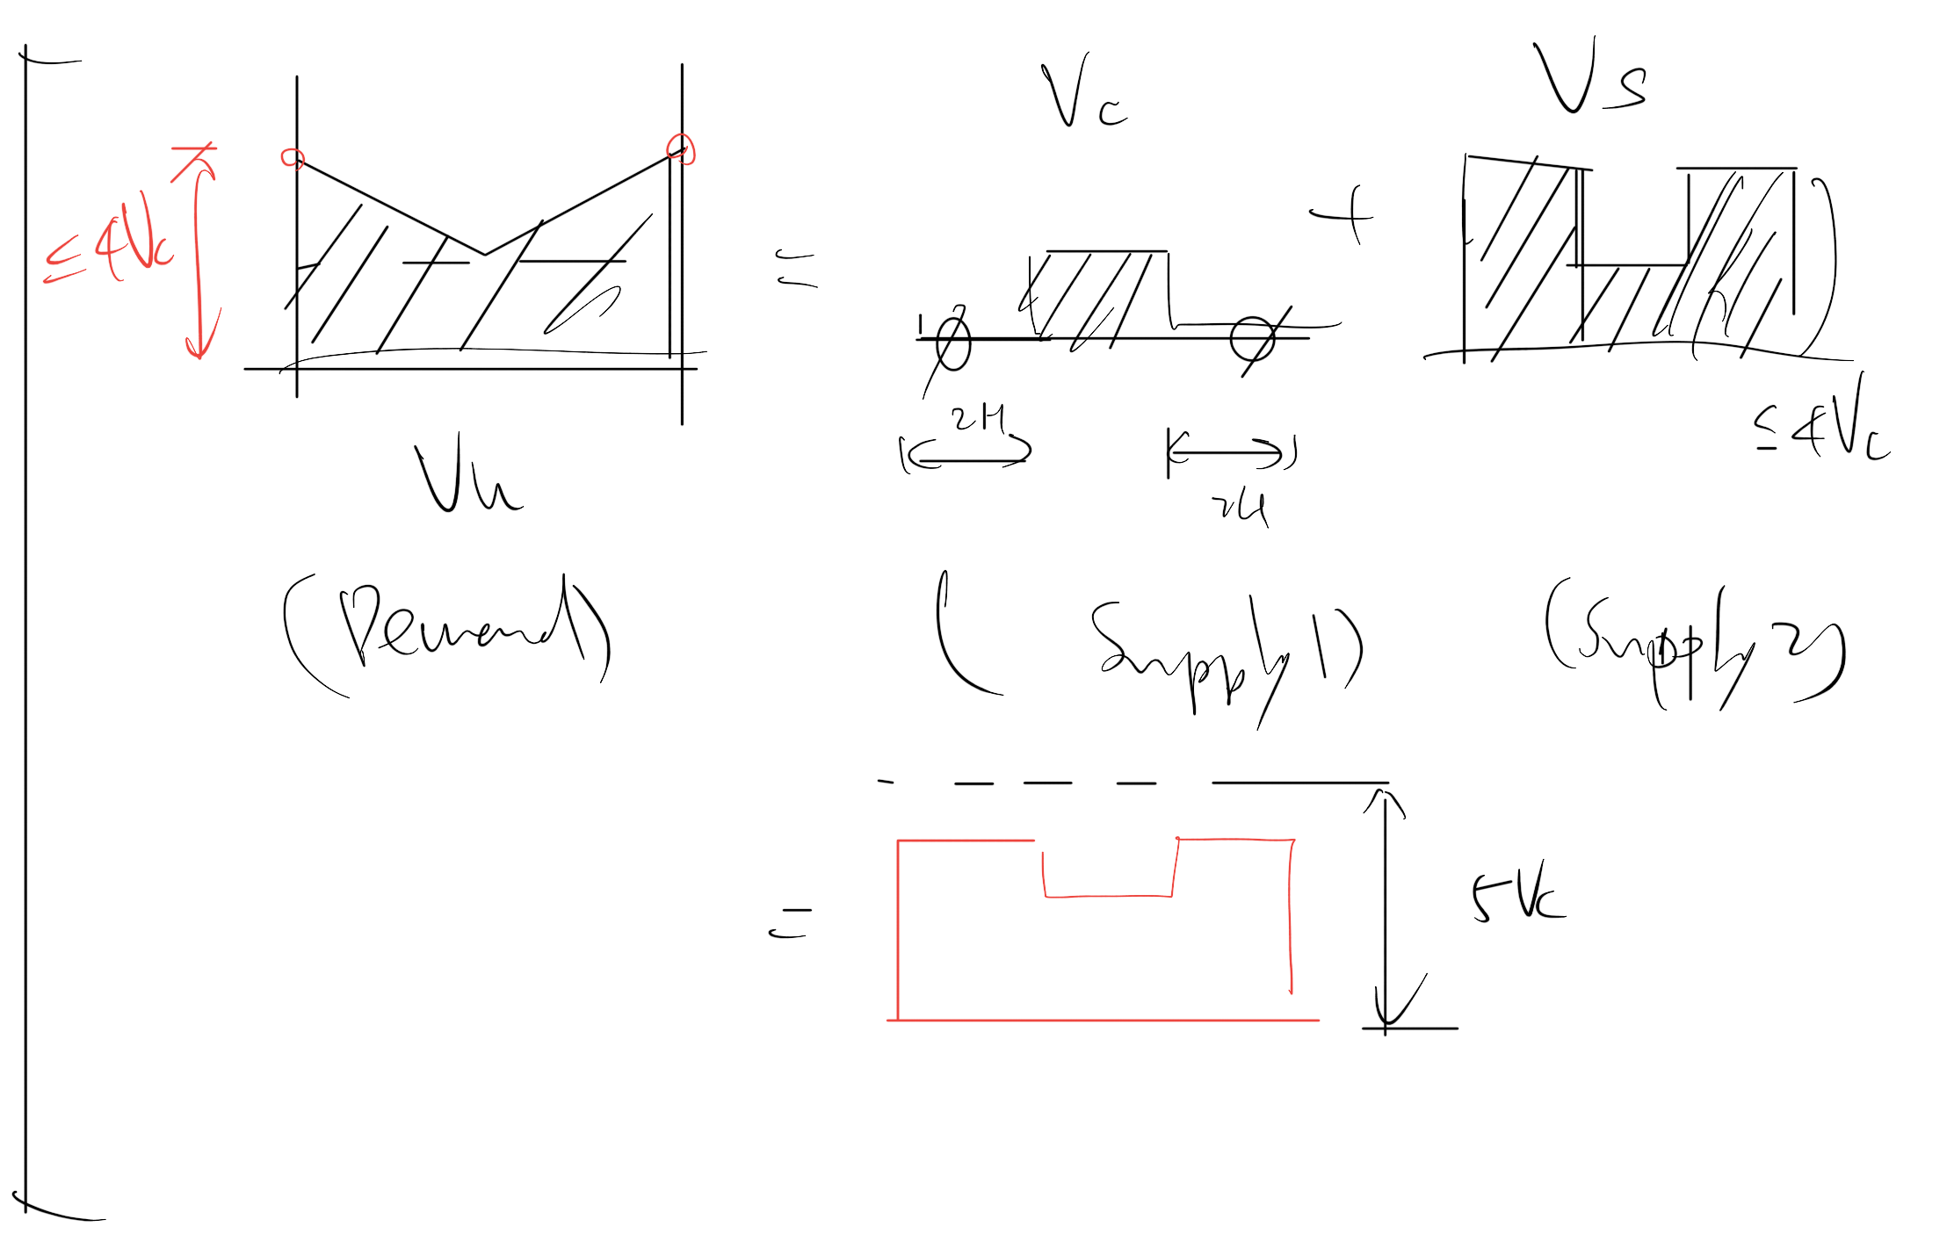

Slide 8
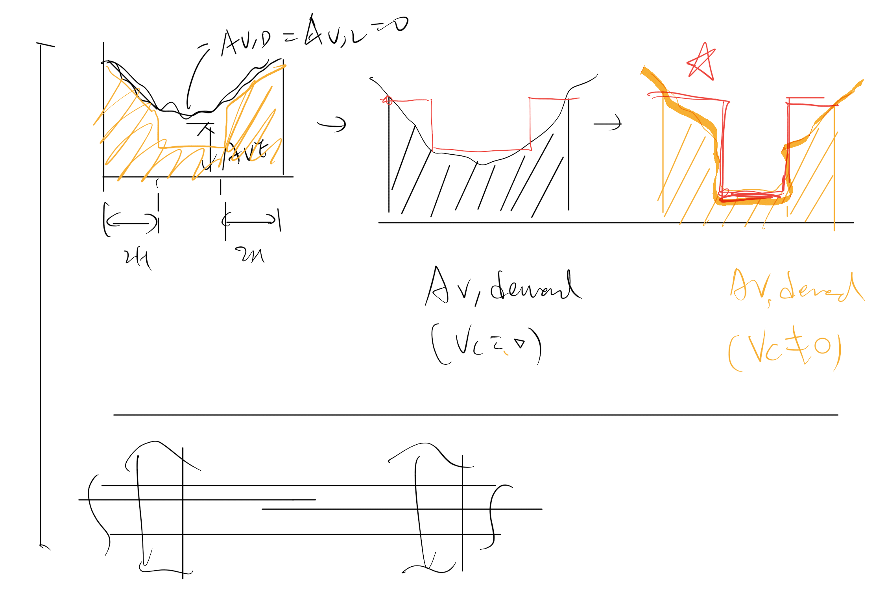

Slide 9
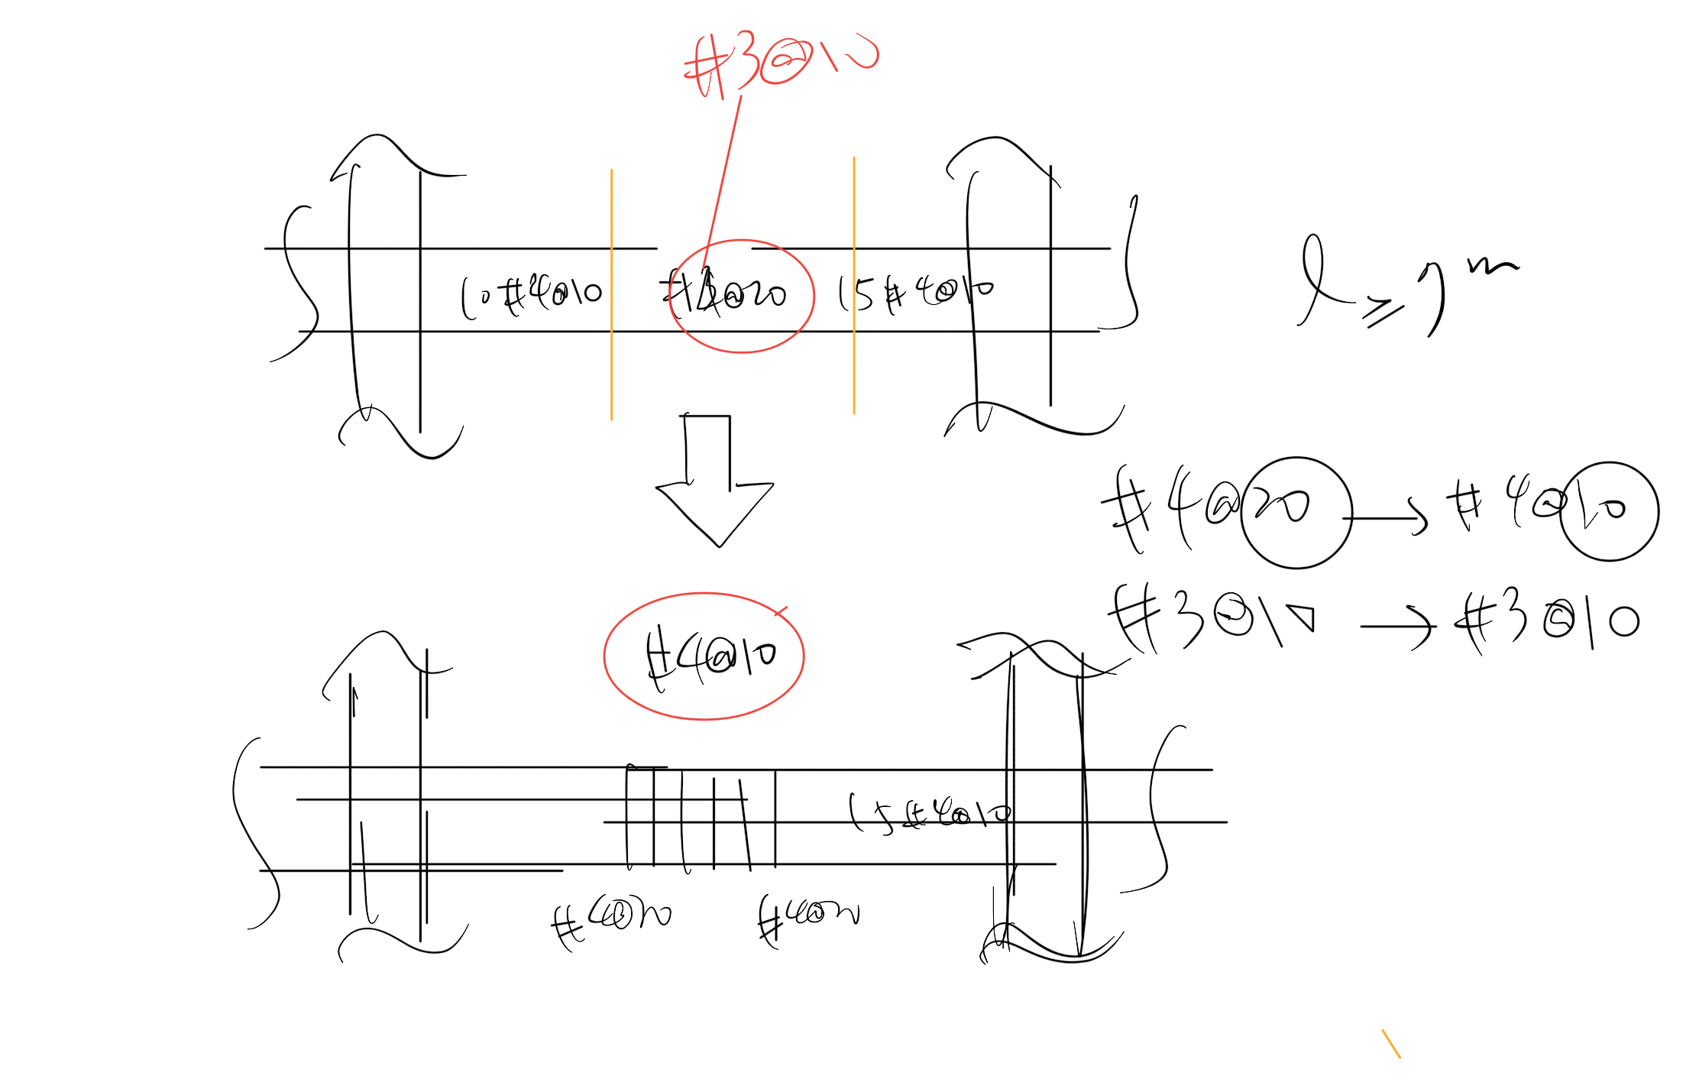

Slide 10
5 MULTI CUT
Pattern
…

Slide 11
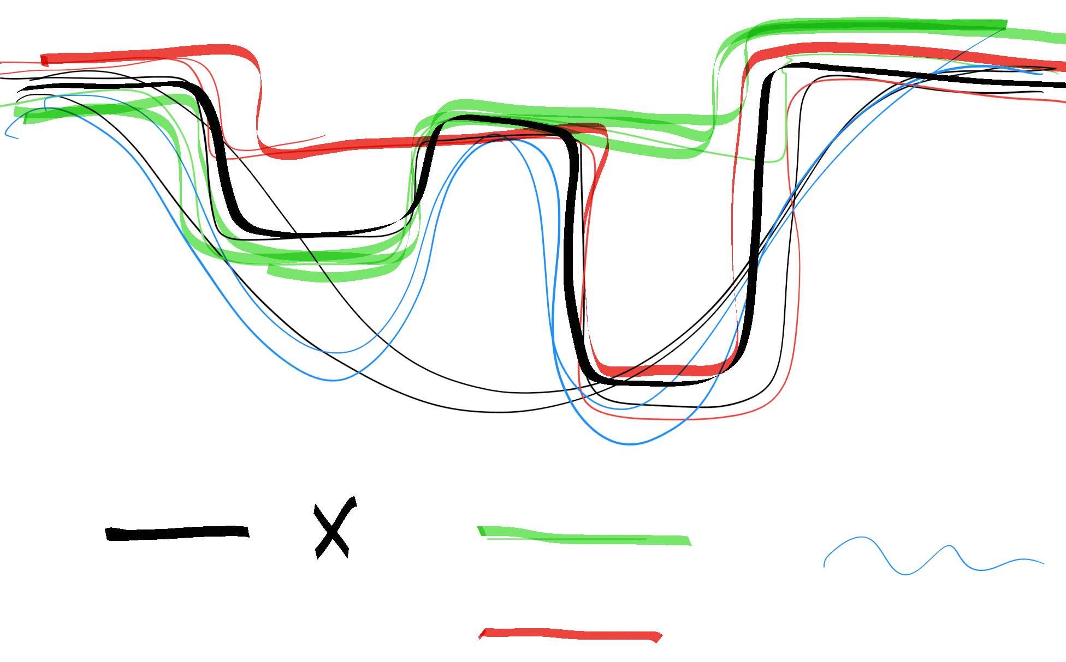
Five
Four
Demand

Slide 12
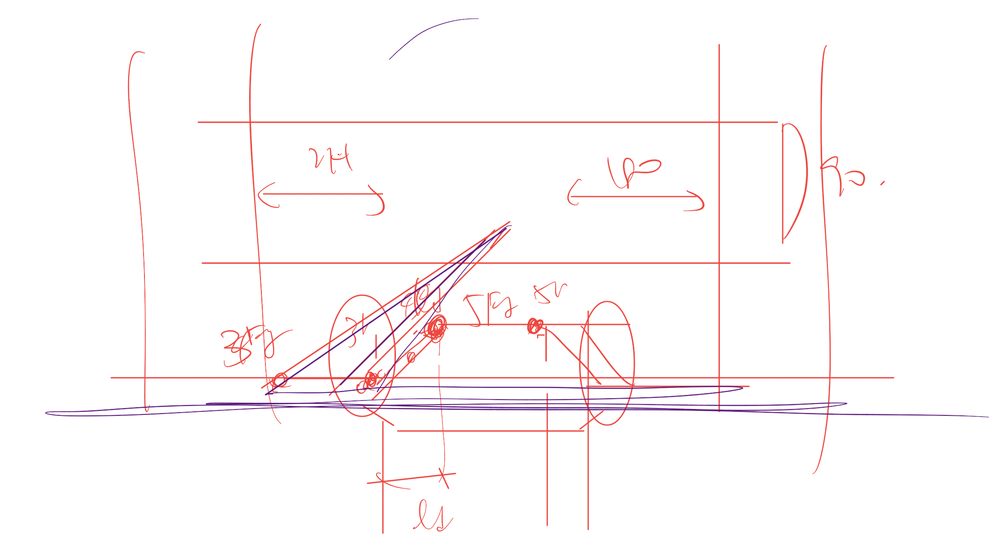
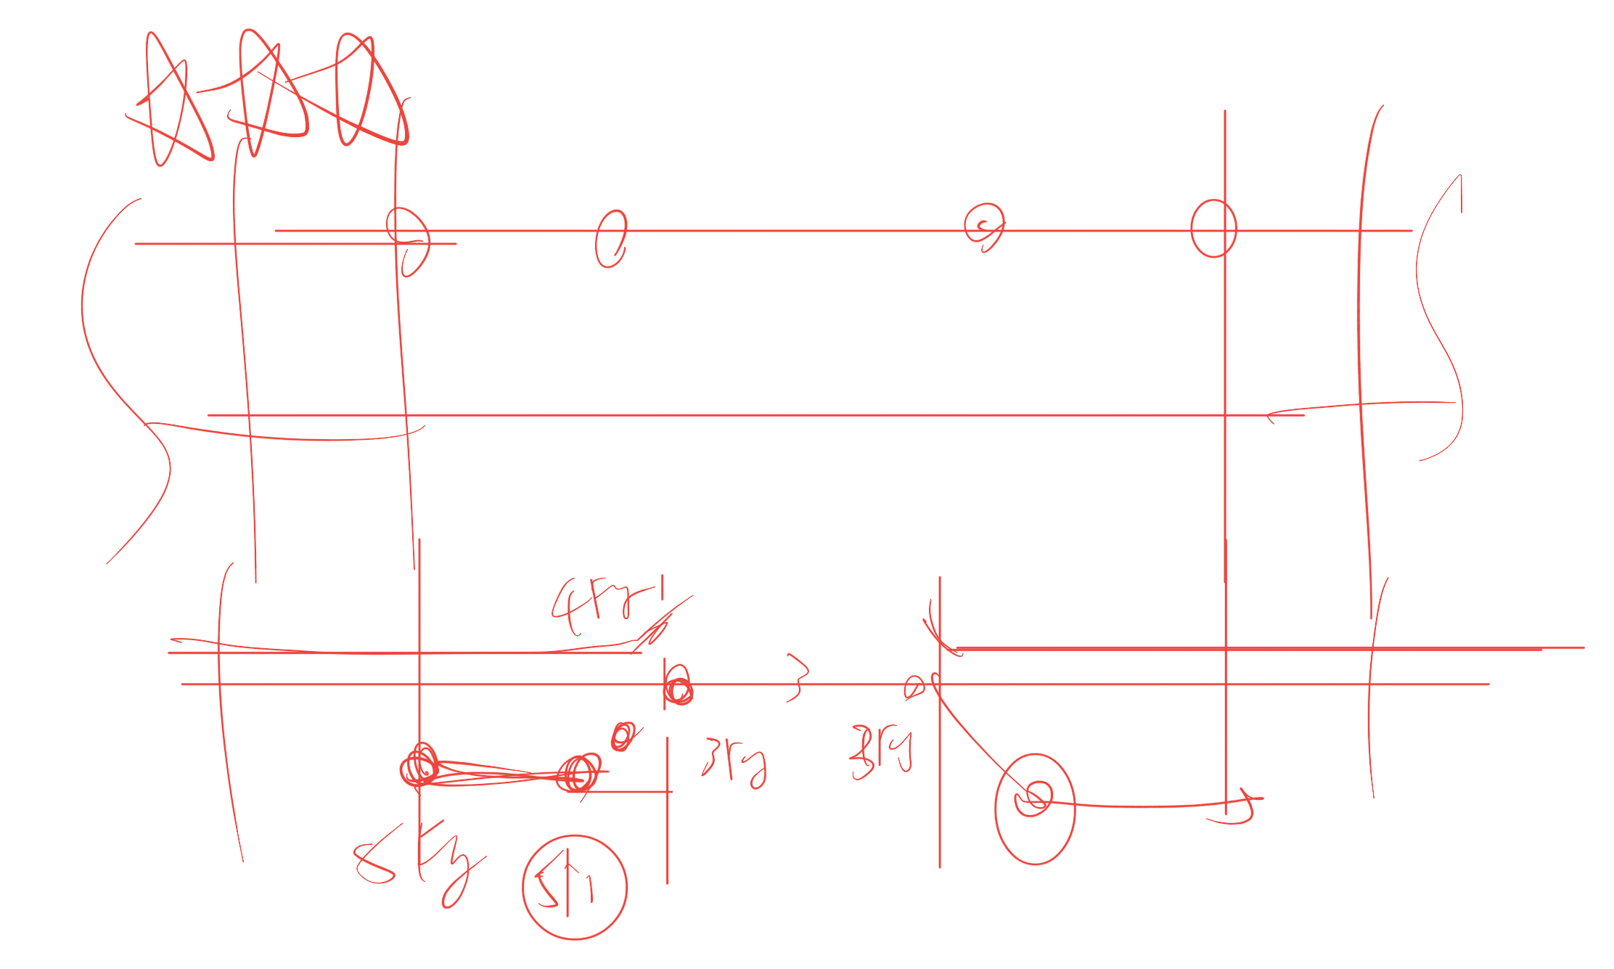
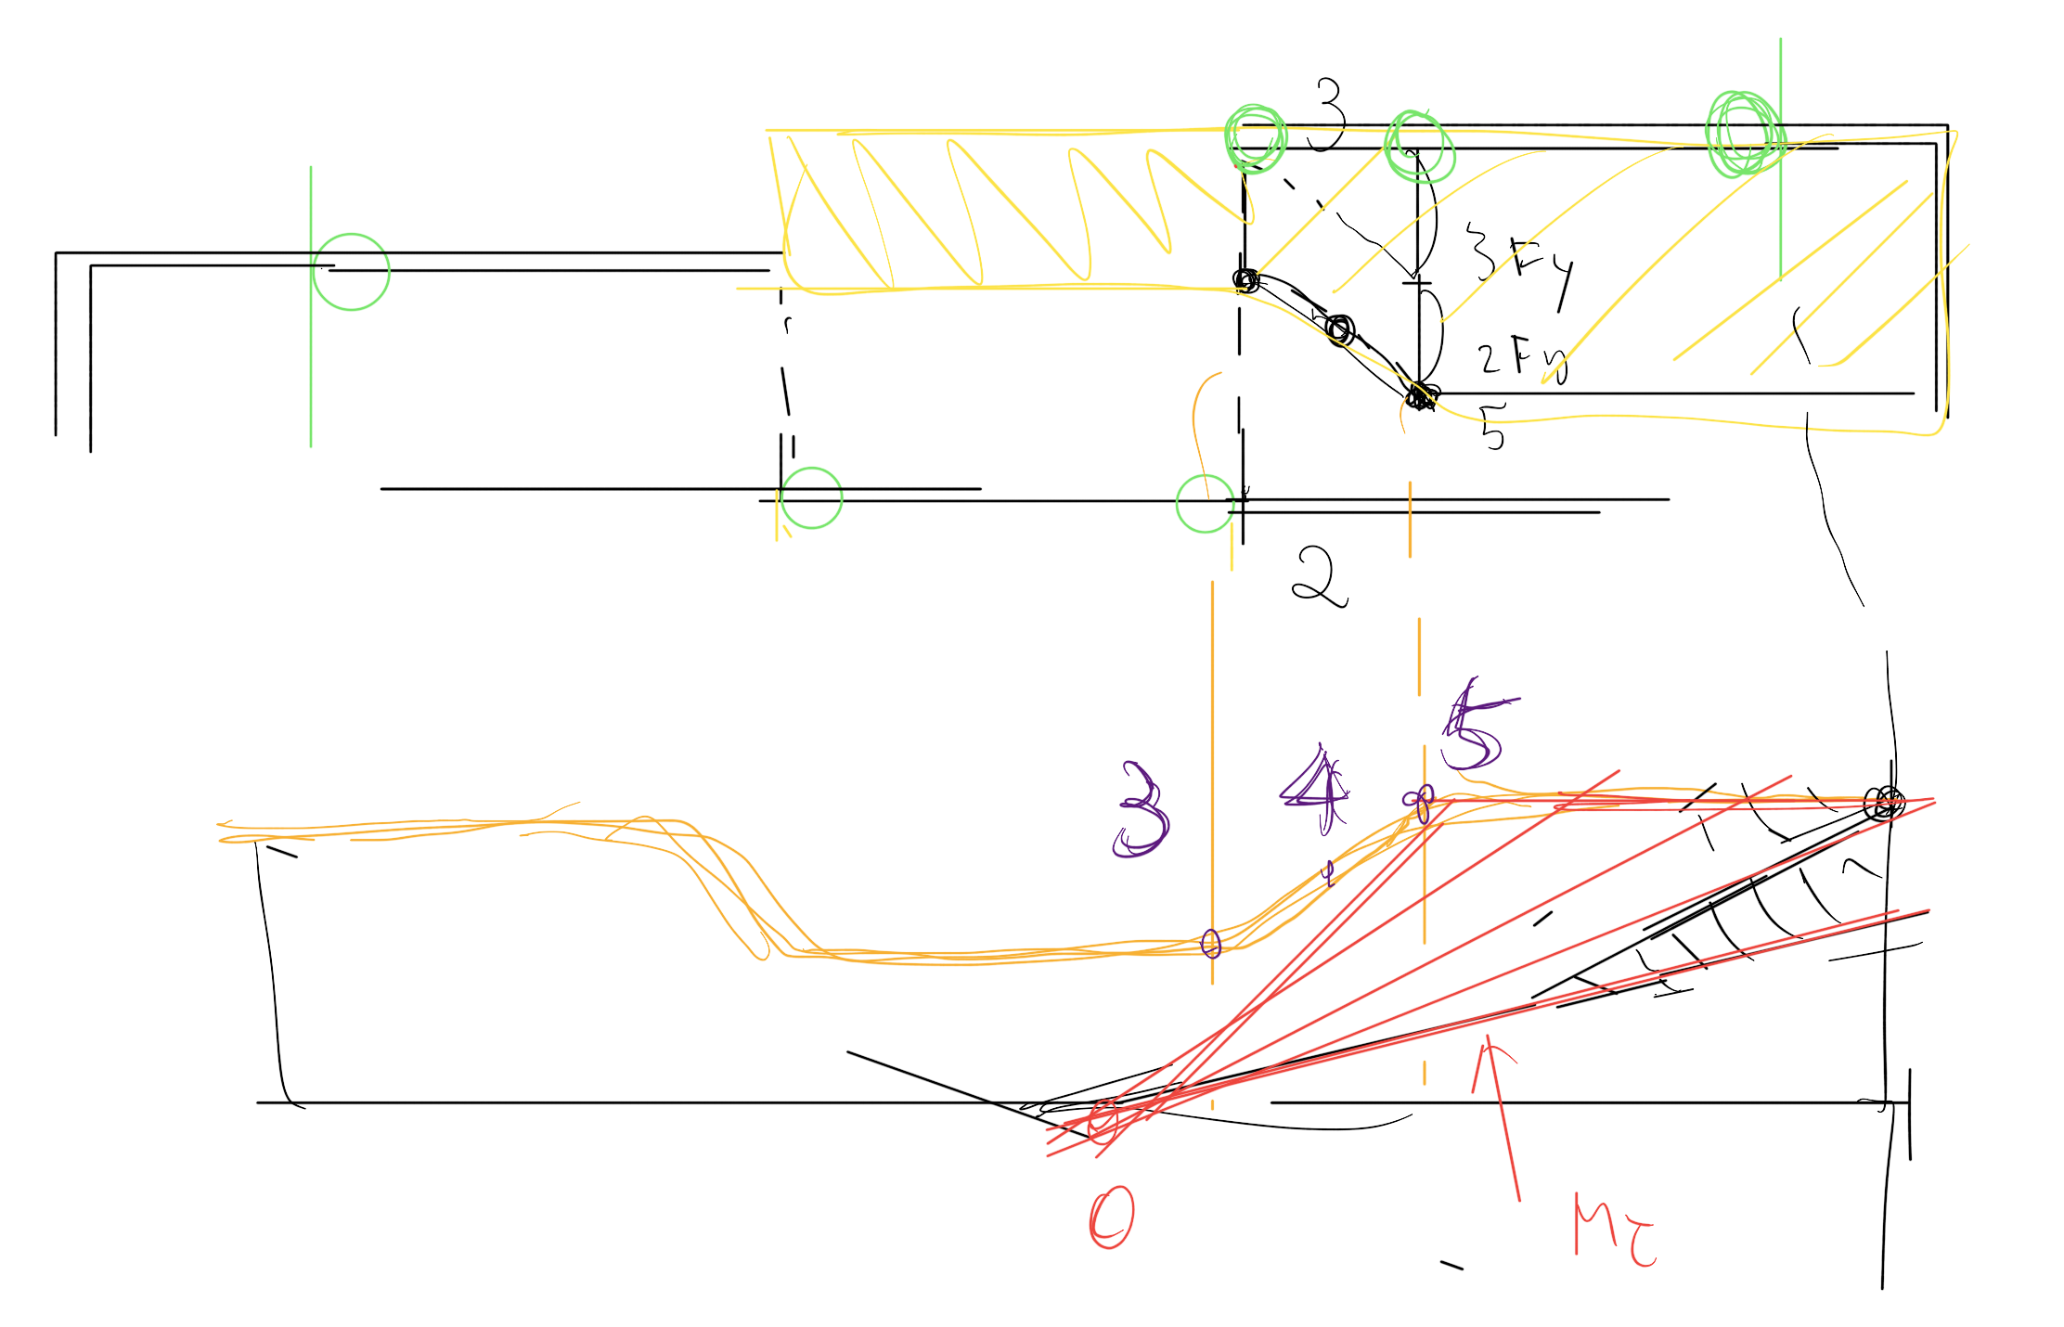
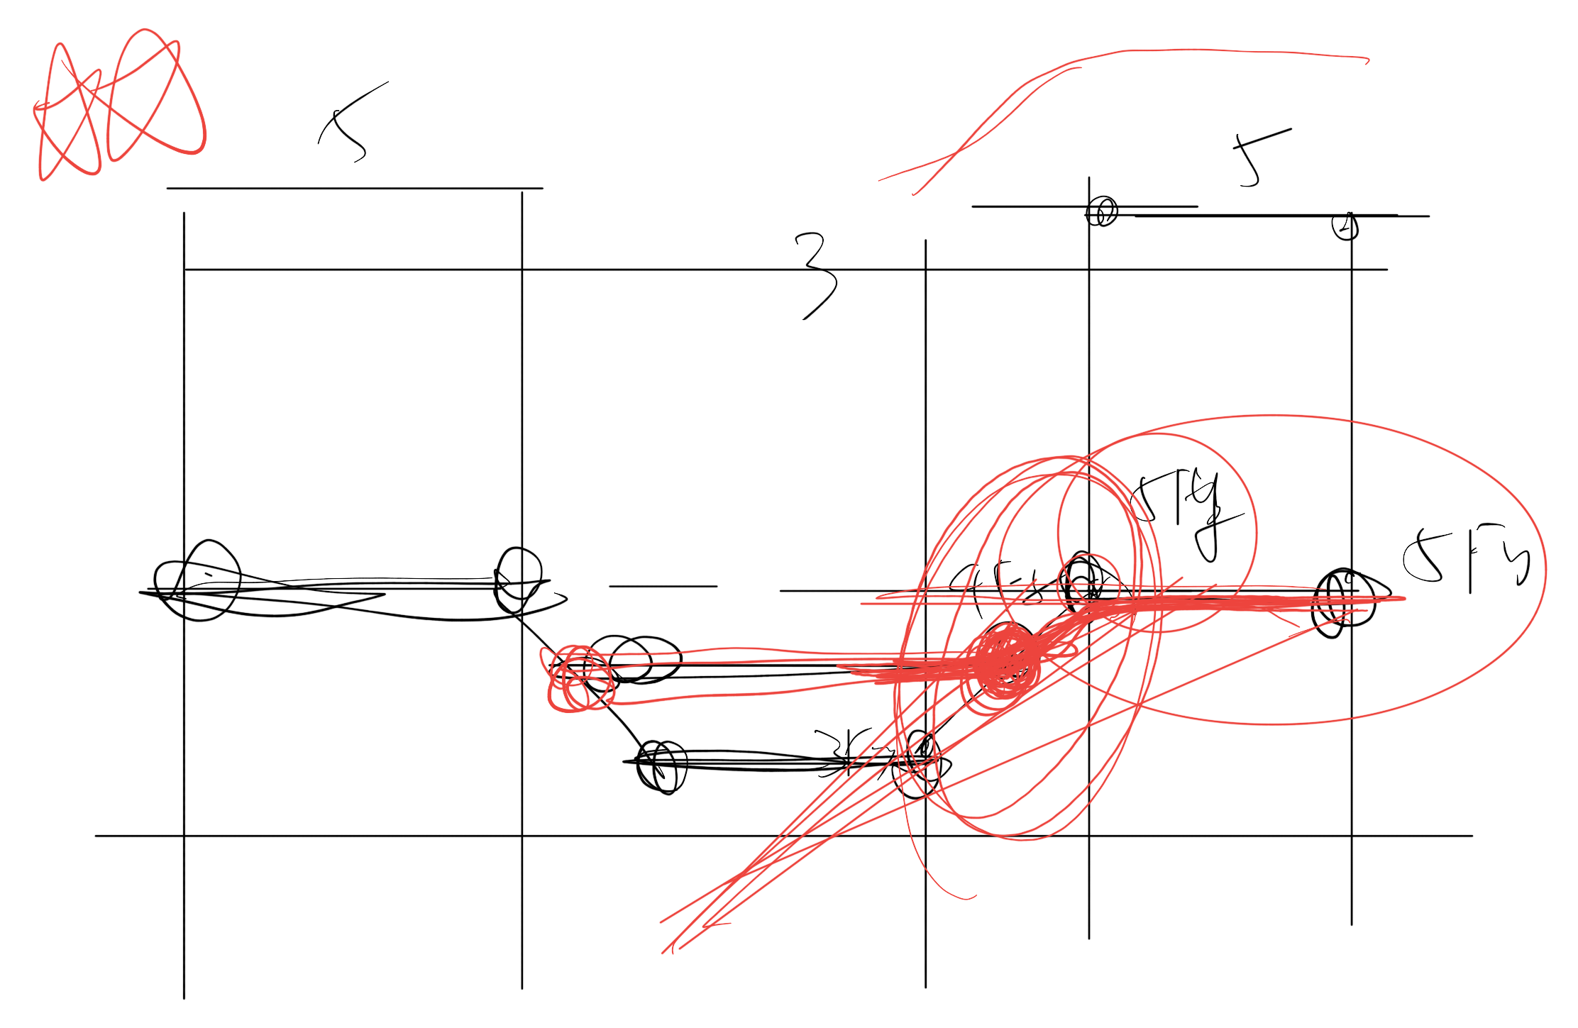

Slide 13
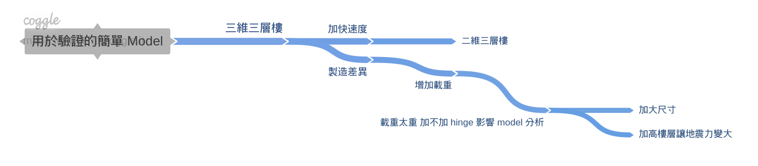
Nonlinear
Simple Model

Slide 14
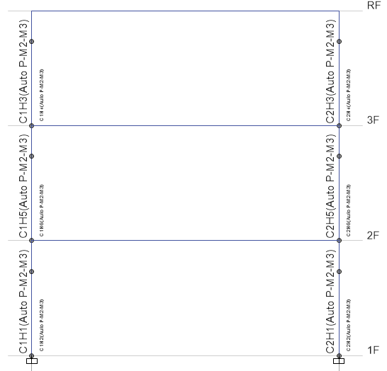
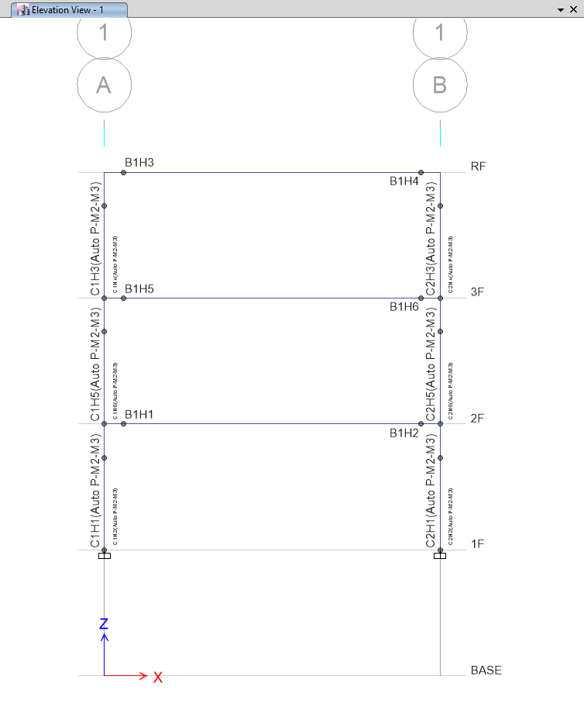
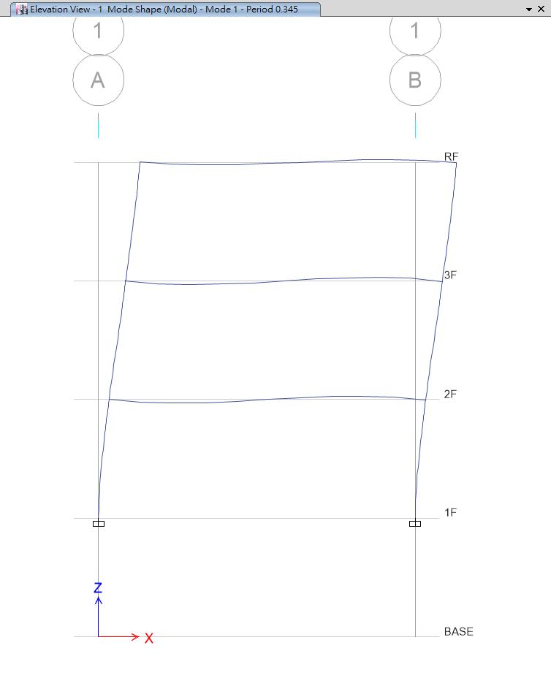
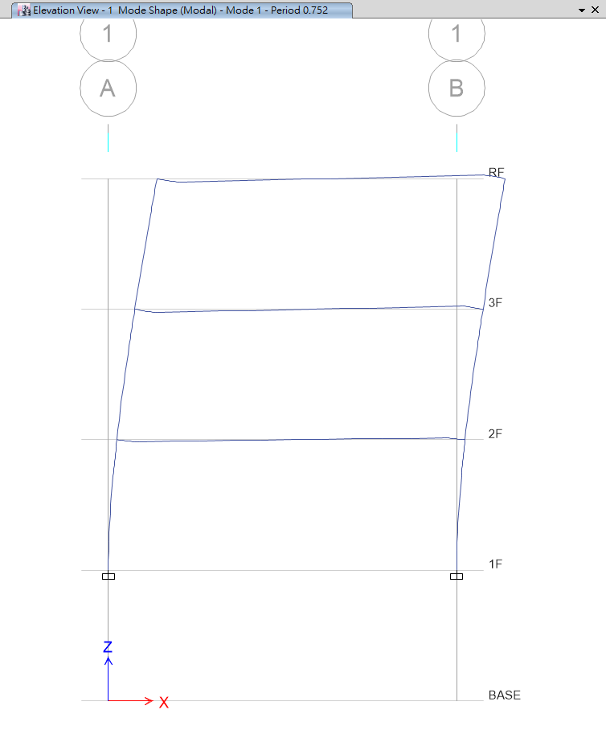
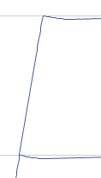
T=0.345
T=0.752
No Nonlinear Beam Hinge
Nonlinear Beam Hinge

Slide 15
Nonlinear
Simple Model

Slide 16
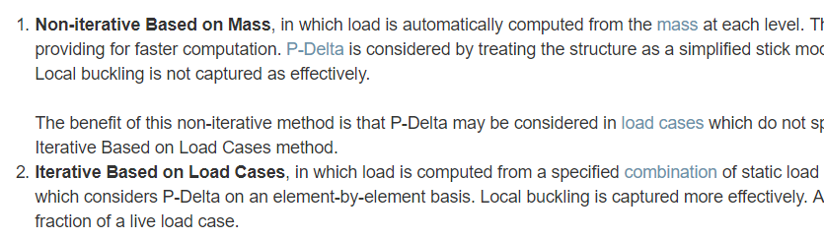
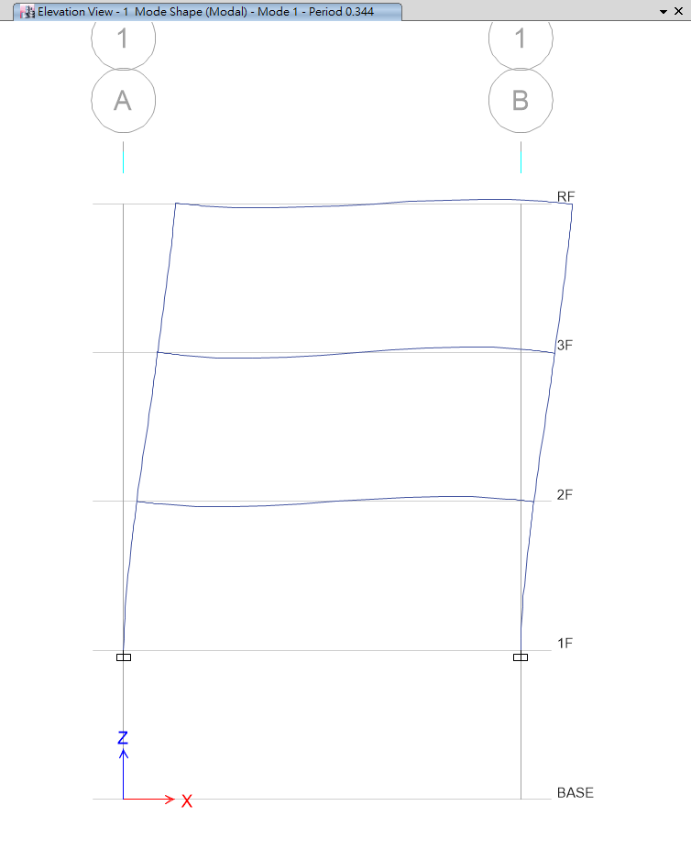
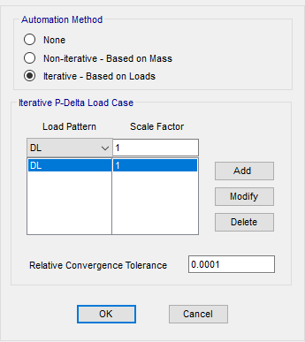
P-Delta
Local Buckling

Slide 17
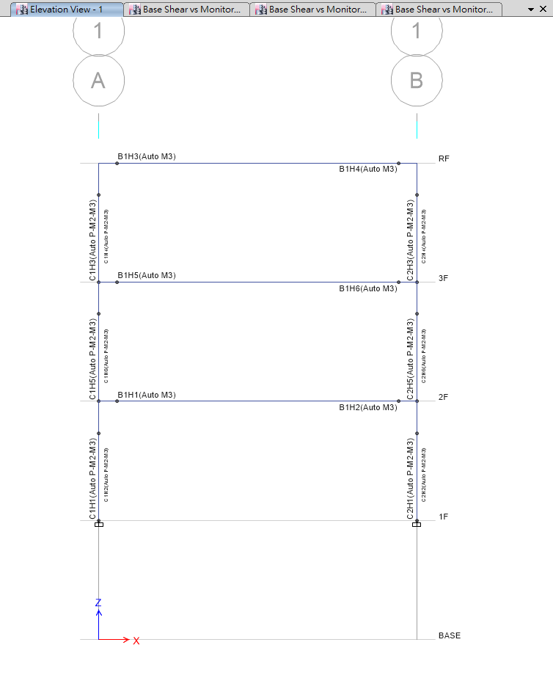
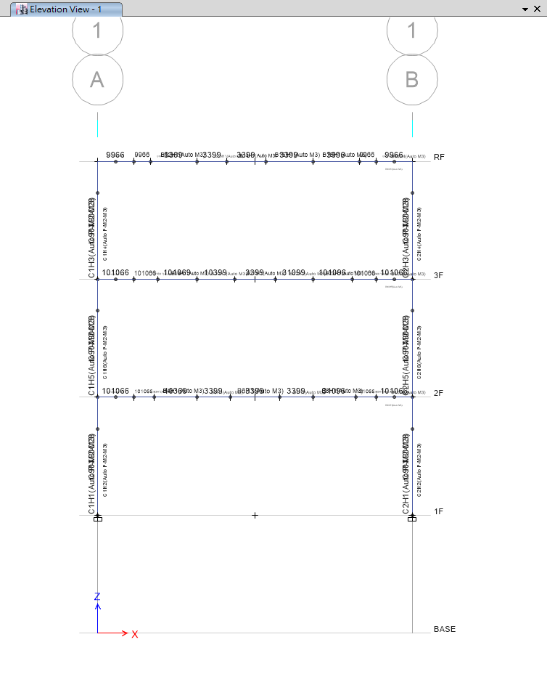
Normal Nonlinear Hinge
Multi Nonlinear Hinge

Slide 18
Multi Nonlinear Hinge
1
2
3
4
5
Multi Rebar
Calculate Ld
Divide Beam
Define Section
Assign Hinge

Slide 19
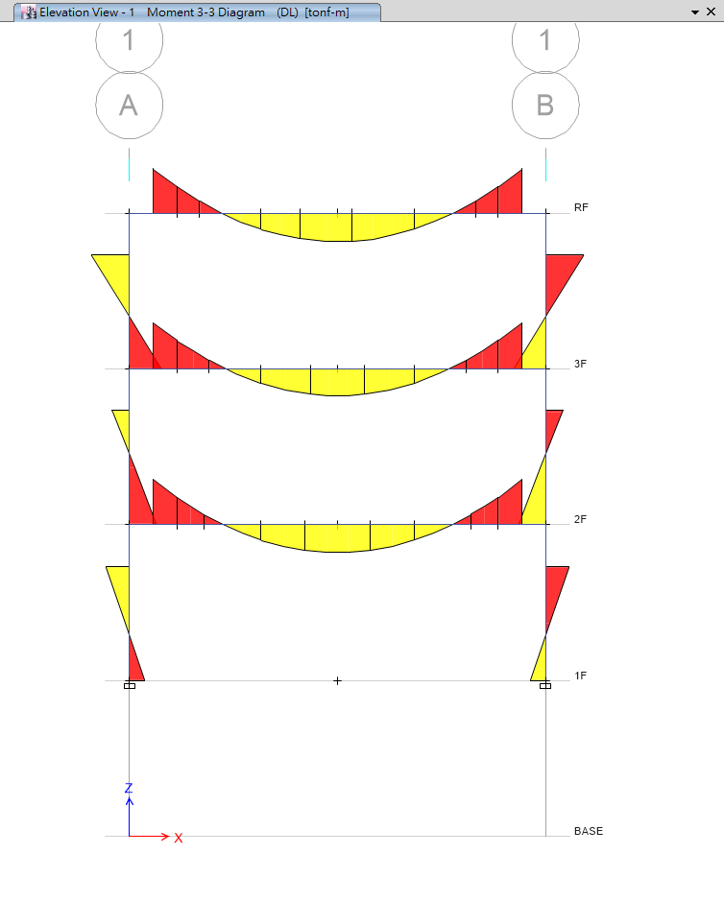
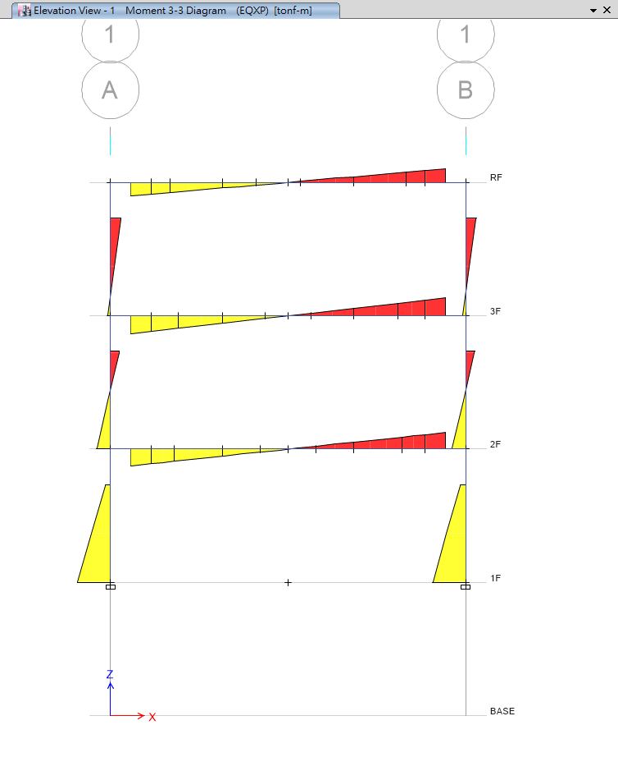

Slide 20
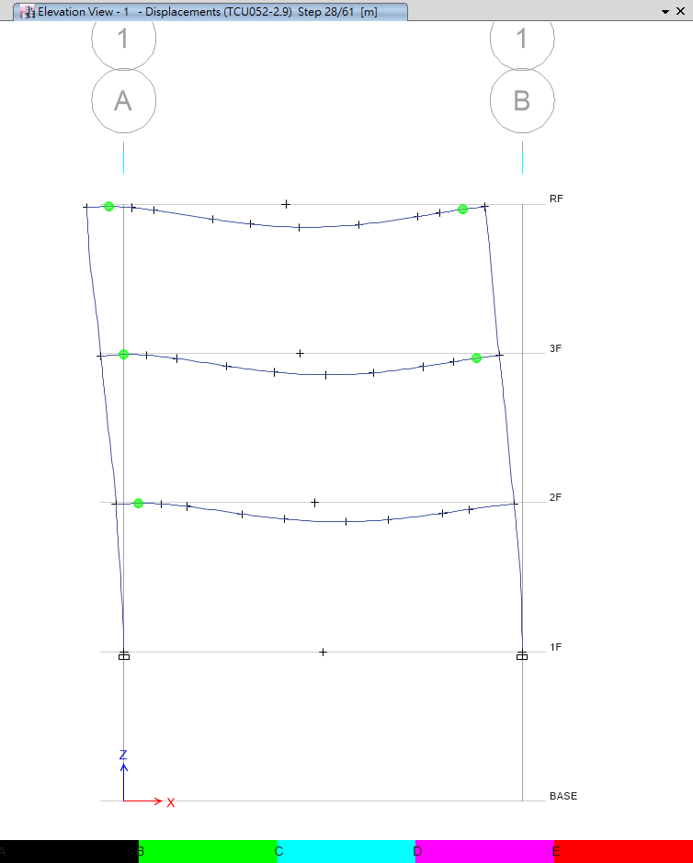
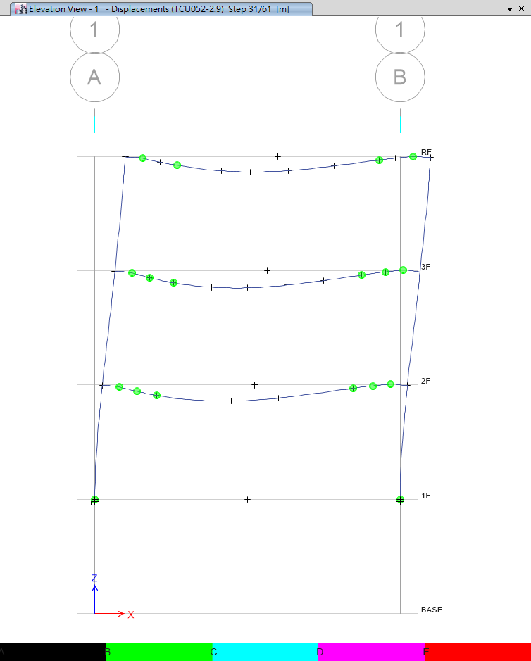
Step 28
Step 31

Slide 21
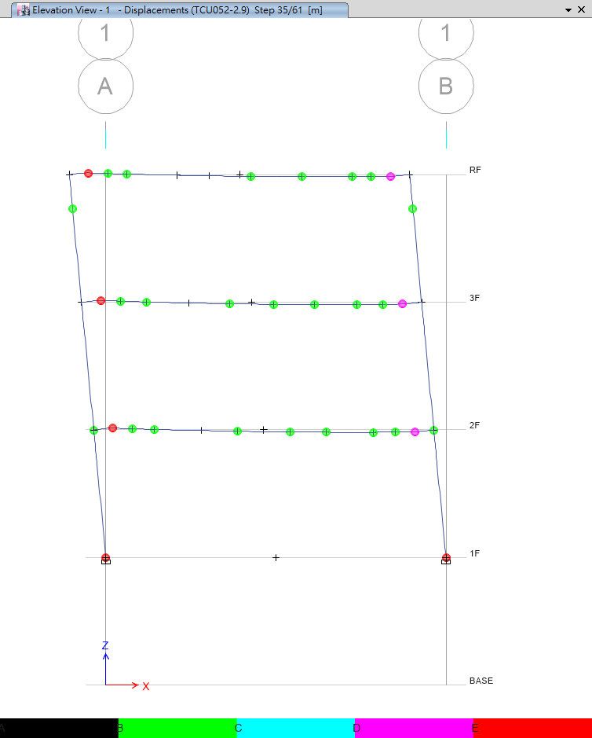
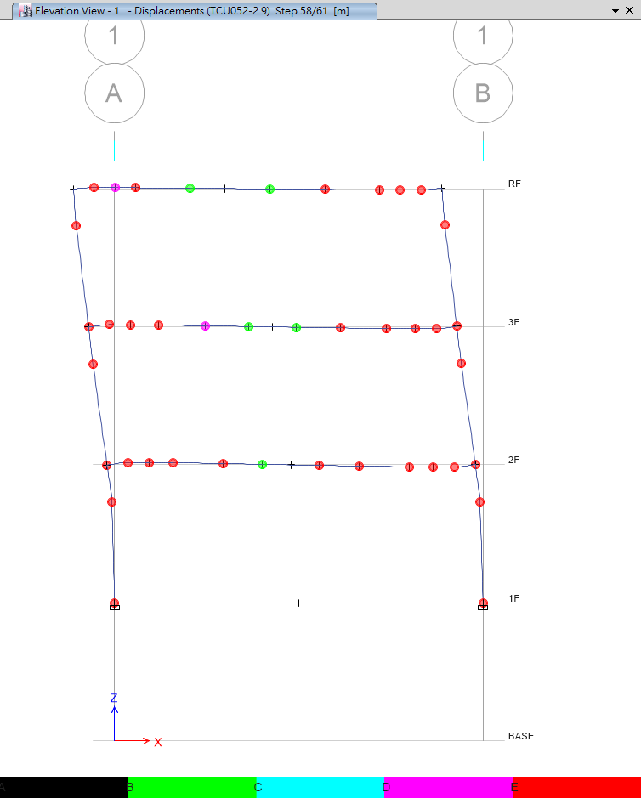
Step 35
Step 58

Slide 22
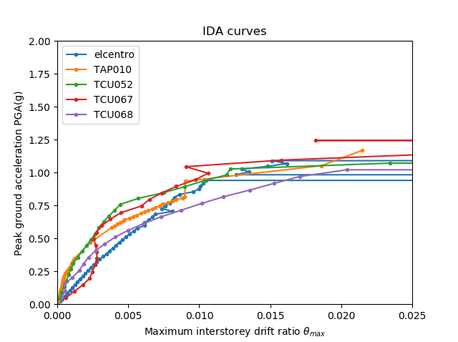
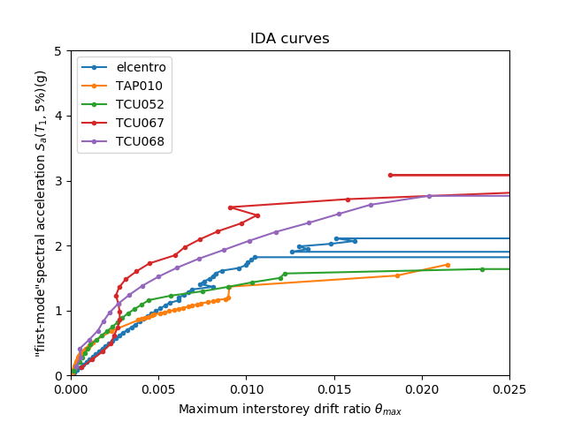
PGA vs First Mode

Slide 23
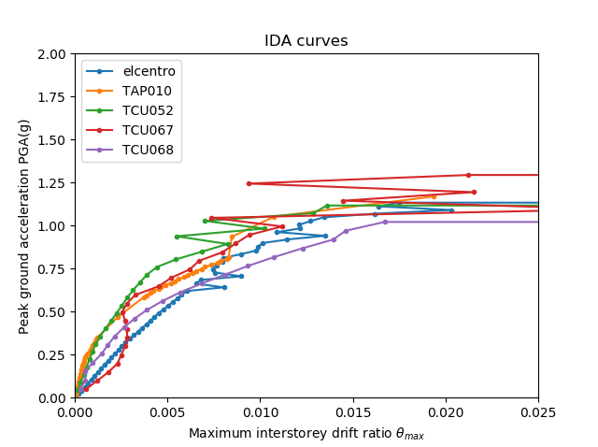
Normal vs Multi

Slide 24
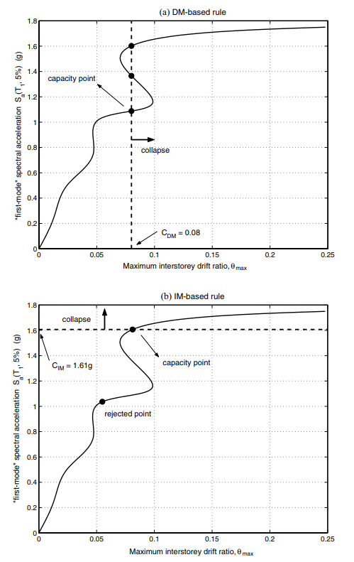
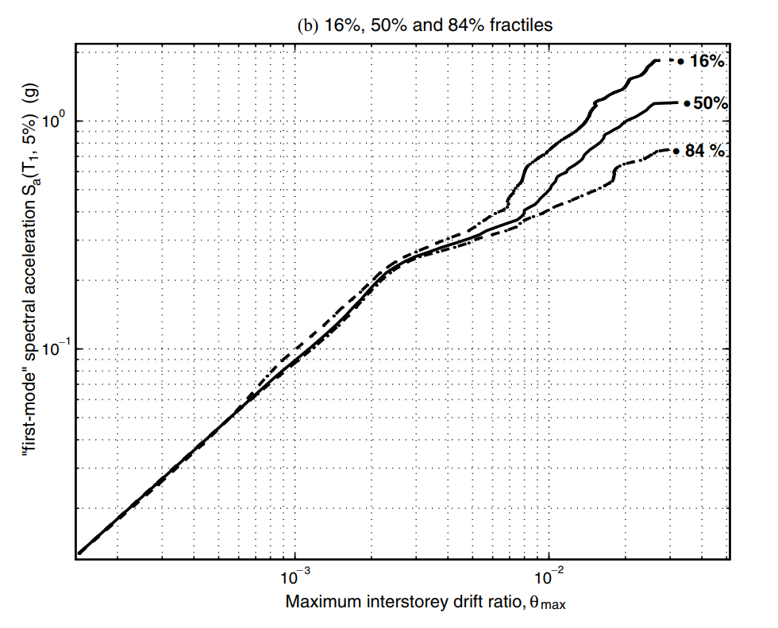
Next to Do

Slide 25
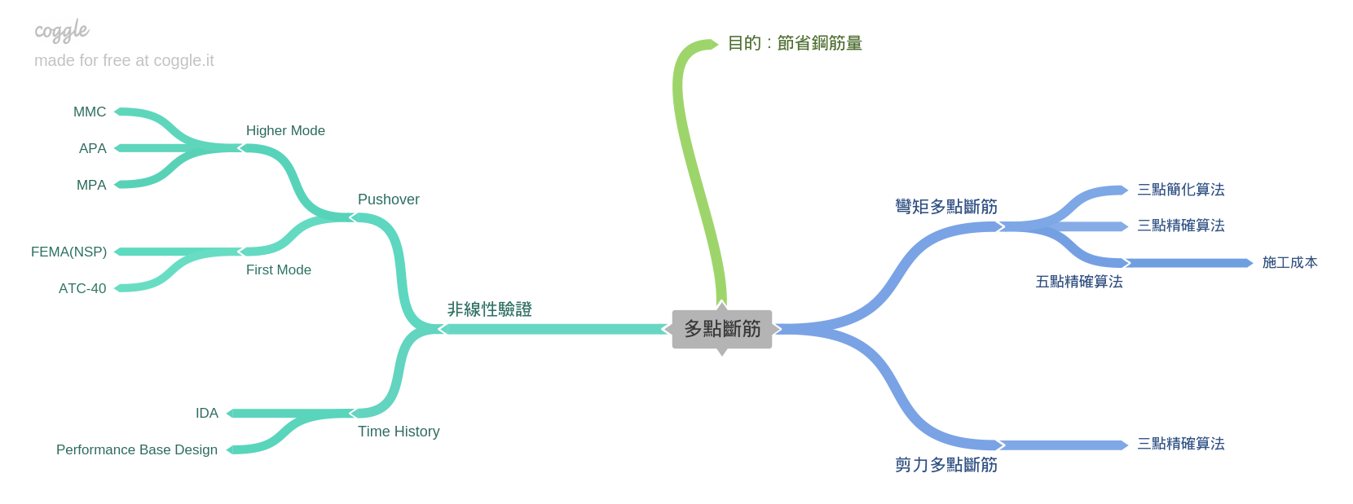
Roadmap

Slide 26
Roadmap
Next
人工斷筋
Now
03/2016
IDA
開發程式

